Slide 1

CPS 564 - Visual Computing and Mixed Reality
Assignment - 1
Pratham Ramkripal Yadav
Jenil Sanjaykumar Pandya
Anant Chanchad
David Geis
Nikesh Chithambaram
Team Members

Slide 2
Problem 1
Problem 1
Analysis
You record a short video (2 minutes) to introduce your group members: name, year, your strength, what you want to do in the future, and how you work together as a team. You upload your video to YouTube and share a link in the submission. Bonus points are for creative introduction videos.
https://youtu.be/x-qr_keKlsU
Create a short video (2 minutes) to introduce group members by covering the following points:
Names
Year (e.g., freshman, sophomore, etc.)
Individual strengths
Future aspirations
How the group works together as a team
The video will be uploaded to YouTube, and the link will be shared for submission. Bonus points are awarded for creativity in the introduction.

Slide 3
Problem 2
Problem 2
Analysis
You are required to write a MATLAB script that reads a color image, and performs the sharpening filter. Note that the output image is also a color image.
The ‘imread’ function reads the image file 'falcon.jpg' into the MATLAB environment for further processing.
The ‘fspecial’ function creates a Gaussian kernel, and `imfilter` applies this kernel to the image to reduce noise.
The sharpened image is obtained by doubling the image and subtracting the Gaussian blurred image, enhancing the edges.
The ‘imshow’ function displays the final sharpened image, ensuring it is in the correct data type format for proper visualization.

Slide 4
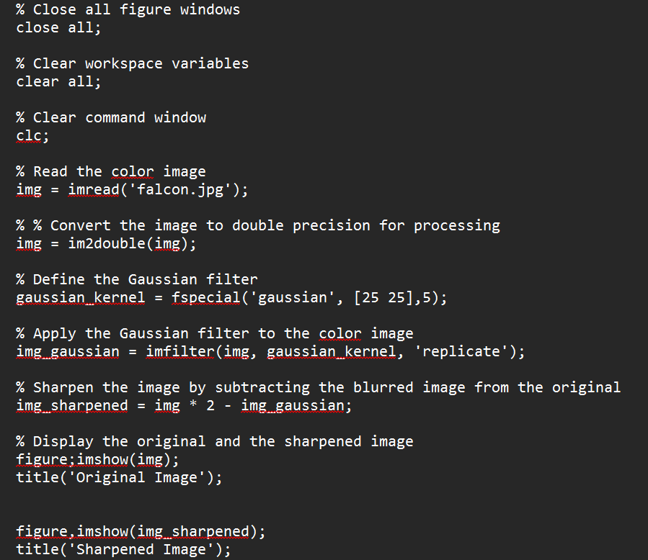
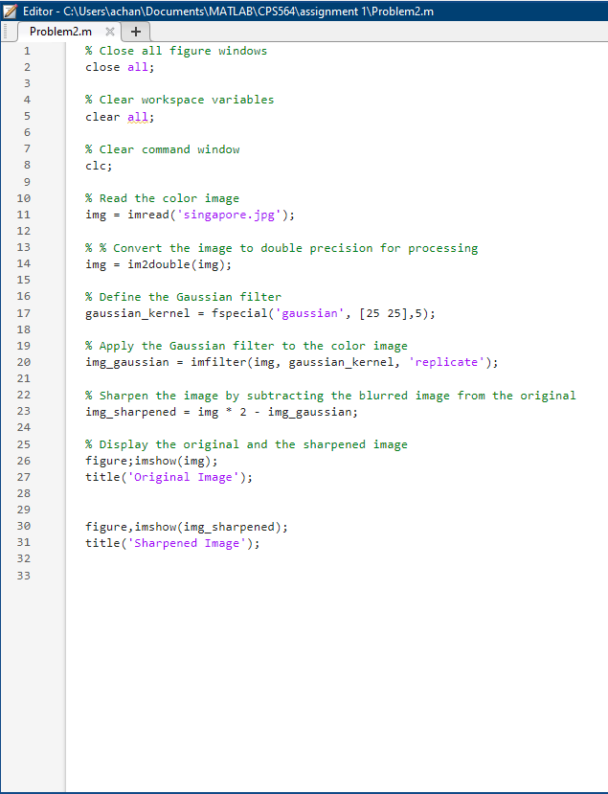
Problem 2 and Output

Slide 5


ORIGINAL IMAGE
SHARPENED IMAGE

Slide 6


Issues for Problem 2
Finding the right img
Ensuring the Right Data type
Solutions
Finding the Right Image as Sharpening Filter and No Sharpening Filter has little to no effect on Some Picture so Finding the Right Image was crucial for the problem
We had to Make the picture type as Double because the Gaussian Filter was of Double data type and the picture was of uint8 type

Slide 7
Problem 3
You are required to write a MATLAB script which reads, converts a color image into grayscale image, and performs non-linear image filtering: min, max and median filtering on the grayscale image. You are not allowed to use any existing functions such as medfilt2, ordfilt2. Note that the neighboring region can be changed, e.g., 3x3, 5x5, or 7x7. Please discuss/elaborate on each filtering method (min, max, and median).
Problem 3
Analysis
The script begins by reading the color image and converting it to grayscale if necessary. It uses the `imread` function to read the image and ‘rgb2gray’ to convert it to grayscale. If the image is already in grayscale, it skips the conversion.
Min filtering is implemented by iterating over each pixel and replacing it with the minimum value found in its neighboring region. The min() function is used for speed since it is a built-in compiled function. This filter is useful for reducing salt noise and bright spots. The ‘filterImage’ function is called with ‘filter_type’ set to "min".
Max filtering works by replacing each pixel with the maximum value from its neighboring region. The max() function is used for speed since it is a built-in compiled function. This helps remove pepper noise and dark spots. The ‘filterImage’ function is called with ‘filter_type’ set to "max".
Median filtering replaces each pixel with the median value from its neighboring region, preserving edges while effectively reducing noise. The median() function is used for speed since it is a built-in compiled function. The ‘filterImage’ function is called with ‘filter_type’ set to "median". This filter is particularly effective at reducing noise while maintaining image detail.

Slide 8
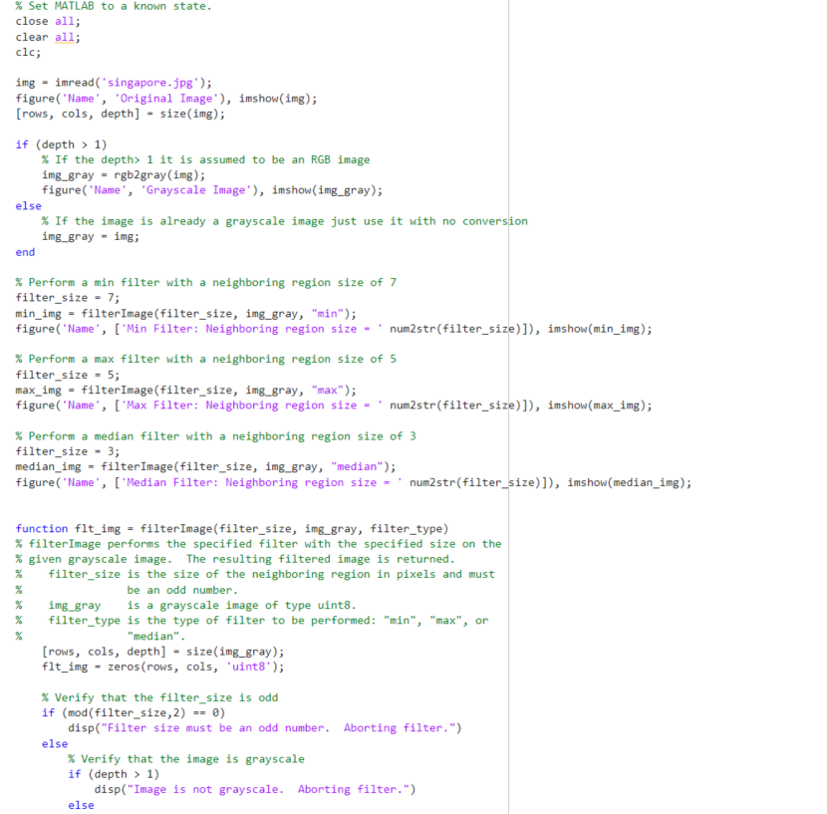
Problem 3 and Output

Slide 9
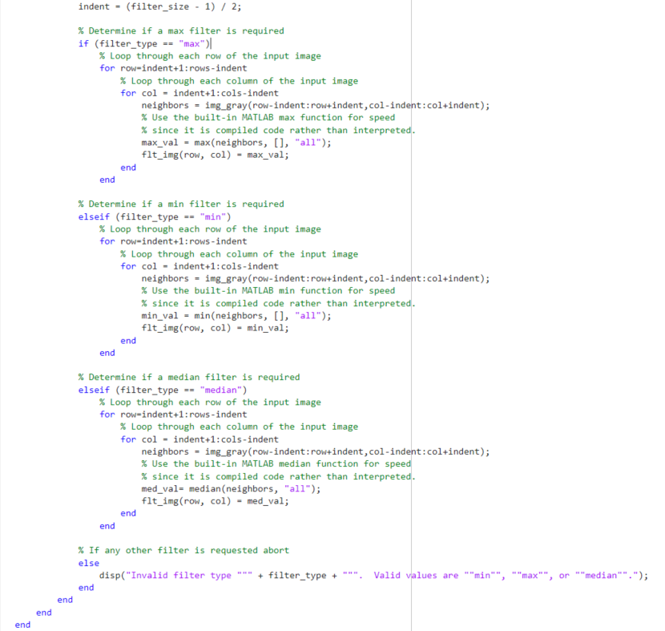

Slide 10
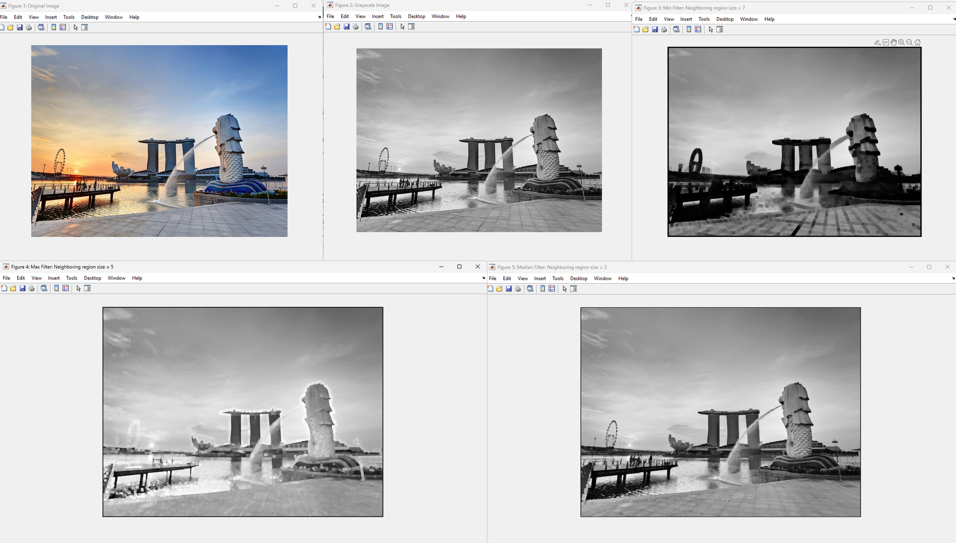
ORIGINAL
GRAYSCALE
MIN FILTER
MAX FILTER
MEDIAN FILTER

Slide 11

Issues
Filter Size Error
Non-Grayscale Image Error
Invalid Filter Type
File Not Found
Ensuring the filter size is an odd number; if not, the function displays an error message and aborts the filter application.
Verifying the image is in grayscale by checking the depth; if not, the function aborts with an error message.
Ensuring a valid filter type (“min”, “max”, “median”) is selected by the user.
Ensuring the image file 'singapore.jpg' is present in the working directory to avoid issues with reading the image and processing.

Slide 12
Solutions
Filter Size Error
Non-Grayscale Image Error
Invalid Filter Type
File Not Found
Implemented a check to ensure the filter size is an odd number before applying the filter. Displayed an appropriate error message if the filter size is even.
Added a check to confirm the image is grayscale before applying the filter. Displayed an appropriate error message if the image has more than one color channel.
Added a check to confirm that a valid filter type is specified. Displayed an appropriate error message if an invalid filter type is given.
Ensure the image file 'singapore.jpg' is in the current working directory or provide the correct path to the file in the `imread` function.

Slide 13

THANK
YOU

